Slide 1

Analysis of Algorithms 1
(Fall 2013)
Istanbul Technical University
Computer Eng. Dept.
Chapter 8: Sorting in Linear Time
Course slides from
Susan Bridges @MS State
have been used in preparation of these slides.
Last updated: October 25, 2011

Slide 2
Purpose
Introduce decision-tree model to study performance limitations of comparison sorts
Prove lower bound on worst-case running time of any comparison sort
Learn about counting sort, radix sort, and bucket sort

Slide 3
Outline
Lower Bounds for Sorting
  Decision Tree Model
Counting Sort
Radix Sort
Bucket Sort

Slide 4
Sorting
Discussed several algorithms that can sort n numbers in O(n lg n) time
  Mergesort and heapsort achieve this upper bound in worst case
  Quicksort achieves it on average
For each of these algorithms, we can produce a sequence of n input numbers that causes the algorithm to run in Ω(n lg n)

Slide 5
Comparison Sorts
These algorithms share an interesting property:
  The sorted order they determine is based only on comparisons between the input elements
We call such sorting algorithms comparison sorts
All the sorting algorithms we have discussed so far are comparison sorts

Slide 6
Detailed Outline
Prove that any comparison sort must make Θ(n lg n) comparisons in the worst case to sort n elements
  Thus, merge sort and heapsort are asymptotically optimal, and no comparison sort exists that is faster by more than a constant factor
Three sorting algorithms that run in linear time
  counting sort, radix sort, and bucket sort

Slide 7
Lower Bounds for Comparison Sorts
Assume:
All elements are distinct
All comparisons are of form a_{i} ≤ a_{j}
Can view any comparison sort in terms of a decision tree

Slide 8
Decision Tree
Consider any comparison based sorting algorithm
Represent its behavior on all inputs of a fixed size with a decision tree
Each tree node corresponds to the execution of a comparison
Each tree node has two children, depending on whether the parent comparison was true or false
Each leaf represents correct sorted order for that path

Slide 9
Decision Tree Diagram
first comparison:
check if a_{i} ≤ a_{j}
YES
NO
second comparison
if a_{i} ≤ a_{j} : check if
a_{k} ≤ a_{l}
second comparison
if a_{i} > a_{j} : check if
a_{m} ≤ a_{p}
YES
NO
YES
NO
third comparison
if a_{i} ≤ a_{j} and a_{k} ≤ a_{l} : check if a_{x} ≤ a_{y}

Slide 10
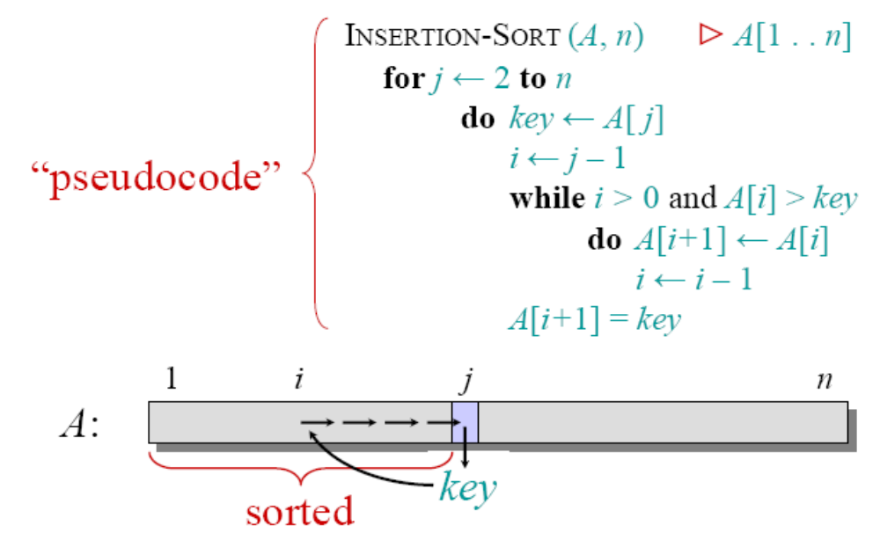
Insertion Sort Algorithm
comparison

Slide 11
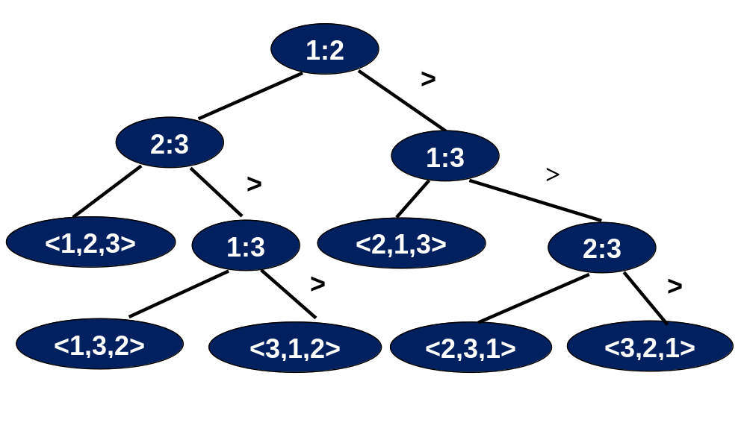
Decision Tree for Insertion Sort (n=3)

Slide 12
How Many Leaves?
Must be at least one leaf for each permutation of the input
  Otherwise, there would be a situation that was not correctly sorted
Number of permutations of n keys is n!
Idea: since there must be a lot of leaves, but each decision tree node only has two children, tree cannot be too shallow
  depth of tree is a lower bound on running time

Slide 13
Lower Bounds for Worst Case
Theorem:
  Any comparison sort algorithm requires Ω(n lg n) comparisons in the worst case.

Slide 14
Lower Bounds for Worst Case (cont.)
Proof:
Let h be height of tree and l be number of leaves
Tree must have at least n! leaves since each permutation of input must be a leaf

Slide 15
Lower Bounds for Worst Case (cont.)
Proof (cont.):
Binary tree of height h has at most 2^{h} leaves
Thus: n! ≤ l ≤ 2^{h}
By taking logarithms:
  h ≥ lg(n!) =lg(n)+lg(n-1)+...+lg(1) ≤nlgn
  = Ω(n lg n)
h = 1,
2¹ leaves
h = 2, 2² leaves
h = 3, 2³ leaves

Slide 16
Lower Bounds for Worst Case (cont.)
Corollary:
  Heapsort and merge sort are asymptotically optimal comparison sorts.
Proof:
  O(n lg n) upper bounds on running times for heapsort and merge sort match Ω(n lg n) worst-case lower bound from the theorem

Slide 17
Counting Sort
Assumes each of the n input elements is an integer in range 0 to k, for some integer k
For each element x, determine number of values ≤ x
  This information can be used to place element x into its position
  Example: 17 elements less than x, x belongs in position 18
Requires three arrays
  Input array A[1..n]
  Array B[1..n] for sorted output
  Array C[0..k] for counting number of times each element occurs (temporary working storage)

Slide 18
Counting Sort (cont.)
COUNTING-SORT (A, B, k)
for i ← 0 to k
do C[i] ← 0
for j ← 1 to length[A]
do C[A[j]] ← C[A[j]] + 1
C[i] now contains the number of elements equal to i
for i ← 1 to k
do C[i] ← C[i] + C[i-1]
C[i] now contains the number of elements less than or equal to i
for j ← length[A] downto 1
do B[C[A[j]]] ← A[j]
C[A[j]] ← C[A[j]] - 1

Slide 19
Counting Sort
A
4
5
1
0
1
3
2
4
1
Max{A[i]}=5 → k = 5
0
1
2
3
4
5
for i ← 0 to k
do C[i] ← 0
C
0
0
0
0
0
0
C
0
for j ← 1 to length[A]
do C[A[j]] ← C[A[j]] + 1
1
0
1
2
3
0
1
0
1
1
2
0
0
1
C
1
4
5
6
8
9
for i ← 1 to k
do C[i] ← C[i] + C[i–1]
1
2
3
4
5
6
7
8
9
A
4
5
1
0
1
3
2
for j ← length[A] downto 1
do B[C[A[j]]] ← A[j]
C[A[j]] ← C[A[j]] – 1
4
1
B
-
0
-
1
-
1
-
1
-
2
-
3
-
4
-
4
5
-
0
1
2
3
4
5
C
1
0
1
4
3
2
5
4
5
6
8
7
6
8
9

Slide 20
Complexity of Counting Sort
COUNTING-SORT (A, B, k)
for i ← 0 to k
do C[i] ← 0
for j ← 1 to length[A]
do C[A[j]] ← C[A[j]] + 1
C[i] now contains the number of elements equal to i
for i ← 1 to k
do C[i] ← C[i] + C[i-1]
C[i] now contains the number of elements less than or equal to i
for j ← length[A] downto 1
do B[C[A[j]]] ← A[j]
C[A[j]] ← C[A[j]] - 1
Lines 1-2 Θ(k)
Lines 3-4 Θ(n)
Lines 6-7 Θ(k)
Lines 9-11 Θ(n)
Total Θ(n+k)

Slide 21
Counting Sort
Beats the lower bound of Ω(n lg n) because it is not a comparison sort
Makes assumptions about the input data
Is a stable sort
  Numbers with the same value appear in the output array in the same order as they do in the input array
  Important if a satellite data are attached to the element being sorted
  Counting sort often used as a subroutine in radix sort

Slide 22
Radix Sort
Origin
  Goes back to late 19th century: Herman Hollerith’s card-sorting machine for 1890 US census
Approach
  Sort numbers digit-by-digit
  Start with the least significant digit

Slide 23
Radix Sort
RADIX-SORT (A, d)
for i ← 1 to d
do use a stable sort to sort array A on digit i

Slide 24
Radix Sort
3 2 9
4 5 7
6 5 7
8 3 9
4 3 6
7 2 0
3 5 5
7 2 0
3 5 5
4 3 6
4 5 7
6 5 7
3 2 9
8 3 9
7 2 0
3 2 9
4 3 6
8 3 9
3 5 5
4 5 7
6 5 7
3 2 9
3 5 5
4 3 6
4 5 7
6 5 7
7 2 0
8 3 9

Slide 25
Inductive Analysis of
Radix Sort
Say it is sorted for the first n digits (columns), consider sorting for the n+1th digit (column)
7 2 0
3 2 9
4 3 6
8 3 9
3 5 5
4 5 7
6 5 7
3 2 9
3 5 5
4 3 6
4 5 7
6 5 7
7 2 0
8 3 9
Case 1
Two numbers differ in digit n+1
Case 2
Two numbers same in digit n+1
Obvious
Sorting must be stable!

Slide 26
Running Time of Radix Sort
Given:
  n d-digit number
  each digit can take k possible values
Radix sort sorts these numbers in Θ(d(n+k)) time
Why?

Slide 27
Running Time of Radix Sort
The running time depends upon the intermediate stable sorting algorithm run for each digit
Assume that counting sort is used for intermediate sorting
Each pass over n d-digit number takes Θ(n+k) time.
Since there are d passes the total running time for radix sort is Θ(d(n+k))

Slide 28
Further Analysis of Radix Sort
Given
  n b-bit number to sort
  r ≤ b
Radix sort sorts these numbers in Θ((b/r)(n+2^{r})) time

Slide 29

Further Analysis of Radix Sort
Words can viewed as having digits of r bits each
Each digit can be considered as an integer between 0 to 2^{r}-1, i.e., k=2^{r} – 1
Each pass of counting sort Θ(n+k)= Θ(n+2^{r})
There are d passes
Total running time
Θ(d(n+2^{r})) = Θ((b/r)(n+2^{r}))

Slide 30
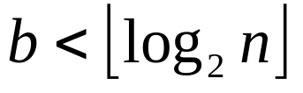
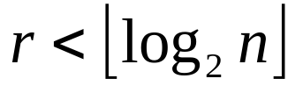
Further Analysis of Radix Sort
Given b and n, minimize the running time, Θ((b/r)(n+2^{r})), where r ≤ b
If any r ≤ b
→ (n+2^{r}) = Θ(n)
If r=b, Θ((b/r)(n+2^{r})) = Θ(n+2^{b}) = Θ(n)

Slide 31
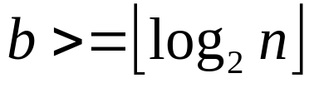
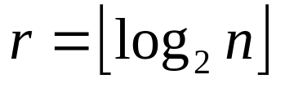
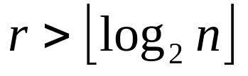
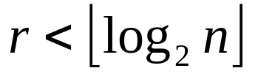
Further Analysis of Radix Sort
Given b and n, minimize the running time, Θ((b/r)(n+2^{r})), where r ≤ b
If , gives the best time
if running time Θ(bn/log n)
if running time Ω(bn/log n)
if running time Θ(n)

Slide 32
Bucket Sort
Runs in linear time when the input is drawn from a uniform distribution
Assumption: Input is uniformly distributed
Approach:
  Divide distribution interval into n equal-sized intervals, i.e. buckets
  Sort the numbers in each bucket
  Go through the buckets in order

Slide 33
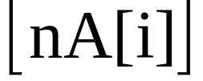
Bucket Sort
BUCKET-SORT(A)
n ← length[A]
for i ← 1 to n
do insert A[i] into list B[ ]
for i ← 0 to n-1
do sort list B[i] with insertion sort
concatenate lists B[0], B[1], …, B[n-1] together in order

Slide 34
Bucket Sort
List Ptr. to
Buckets Buckets
.78 null
.17 → .12|→ .17|null
.39 → .21|→ .23|→ .26|null
.26 → .39|null
.72 null
.94 null
.21 → .68|null
.12 → .72|→ .78|null
.23 null
.68 → .94|null

Slide 35
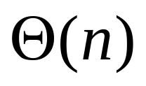

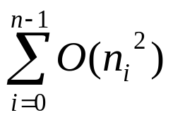
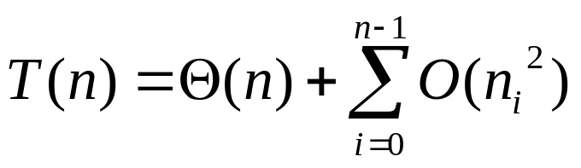
Running Time of Bucket Sort
for i ← 1 to n
do insert A[i] into list B[ ]
for i ← 0 to n-1
do sort list B[i] with insertion sort
concatenate lists B[0], B[1], …, B[n-1] together in order

Slide 36
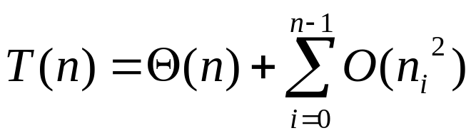
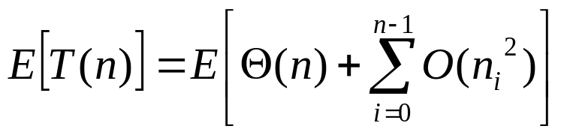
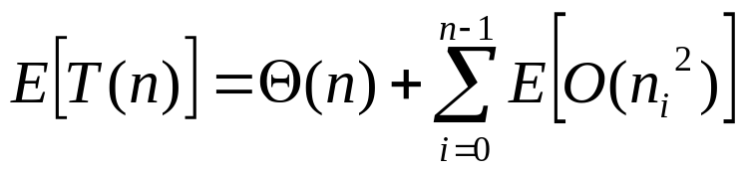
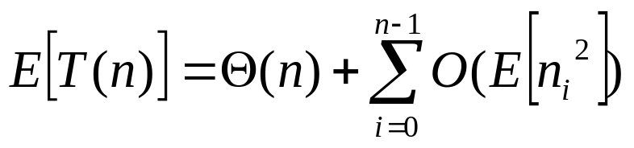
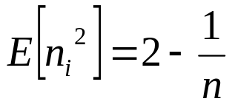
Running Time of Bucket Sort
Taking expected values of both sides
→ Θ(n) + n O(2 - 1/n) = Θ(n)
See page 175-176 of the book

Slide 37
Summary
Lower Bounds for Sorting
  Decision Tree Model
Counting Sort
Radix Sort
Bucket Sort

